Slide 1
Implementation of a 76GHz-81GHz Automotive FMCW Radar Transceiver and PLL in GF22nm FDSOI
Mina Ashraf Ishak Fawzy – 1200289
Mohamed Essam – 1200059
Omar Mohamed Said – 1200859
Aley Eldin El-Hiny – 1200475
Abdelraouf Bakkar – 1200186
Kerolos Hanna Fayez – 1200049
Dr. Faisal Hussien
Dr. Ahmed Emira

Slide 2
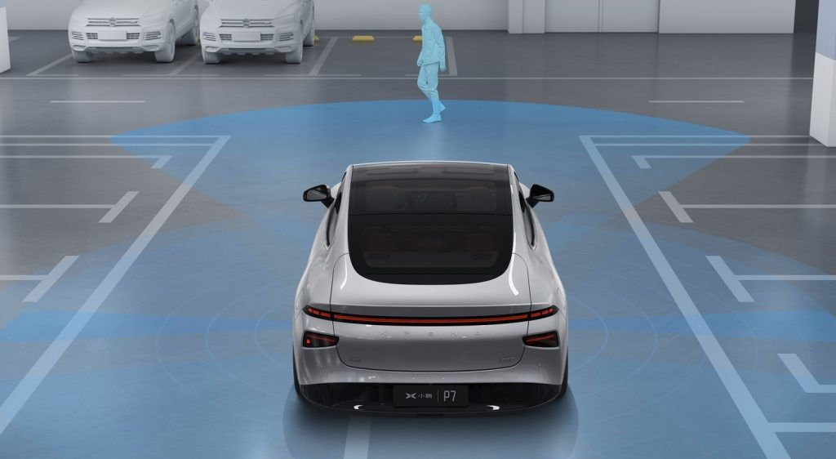

Implementation of a 76GHz-81GHz Automotive FMCW Radar Transceiver and PLL in GF22nm FDSOI

Slide 3
Agenda
Introduction to FMCW Radar Systems
System Specifications Formulation
PLL System Formulation
PLL Circuits Design
Charge Pump and Phase-Frequency Detector
Voltage-Controlled Oscillator
Frequency Dividers
Transmitter System Description
Transmitter Circuits Design
Variable Gain Amplifier
Power Amplifier
Receiver System Description
Receiver Circuits Design
Low-Noise Amplifier
Mixer and Local Oscillator Chain
Baseband Amplifiers

Slide 4

Introduction to FMCW Radar Systems

Slide 5
Agenda
Introduction to FMCW Radar Systems
System Specifications Formulation
PLL System Formulation
PLL Circuits Design
Charge Pump and Phase-Frequency Detector
Voltage-Controlled Oscillator
Frequency Dividers
Transmitter System Description
Transmitter Circuits Design
Variable Gain Amplifier
Power Amplifier
Receiver System Description
Receiver Circuits Design
Low-Noise Amplifier
Mixer and Local Oscillator Chain
Baseband Amplifiers

Slide 6
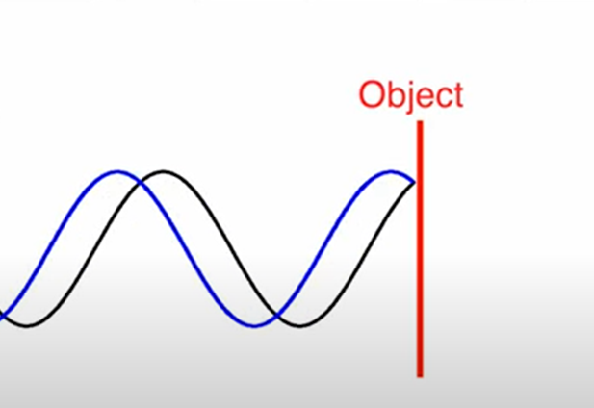
Intro to Radar Systems: Theory of Operation
A signal is transmitted and reflected back from a detected object
The difference in frequency between the Tx and Rx signals is the beat frequency.
The beat frequency between the Rx and Tx is used to determine the distance

Slide 7
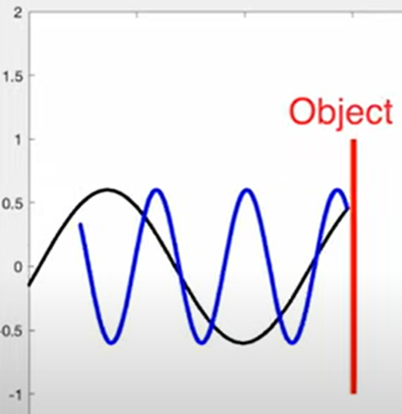
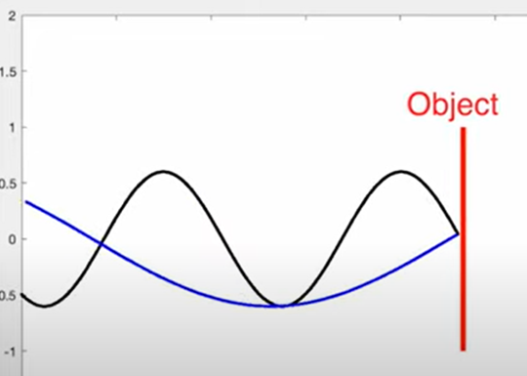
Intro to Radar Systems: Theory of Operation
The beat frequency is not enough to distinguish between different objects.
Stationary
Objects moving towards the Tx
Objects moving away from the Tx

Slide 8
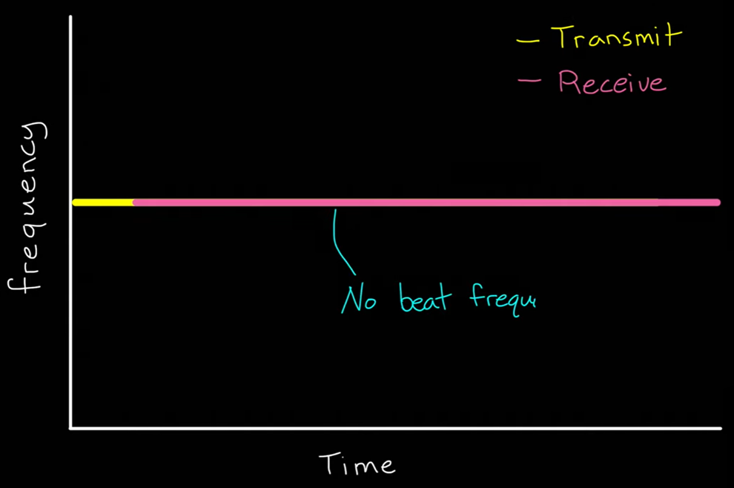
Intro to Radar Systems: Modulating Signals
1. Sinusoidal Signal
Fails to model stationary objects (cannot measure distance)

Slide 9
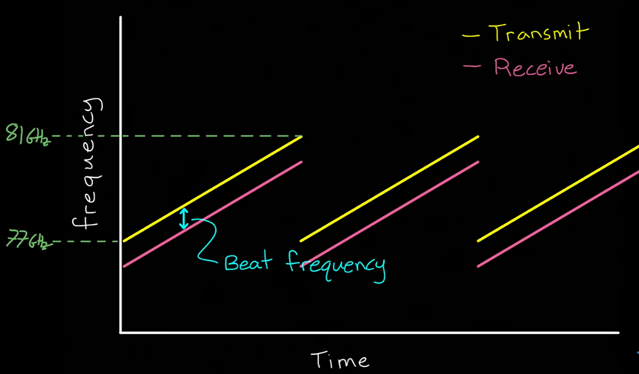
Intro to Radar Systems: Modulating Signals
2. Sawtooth Signal
Fails to distinguish between doppler shift and time delay

Slide 10
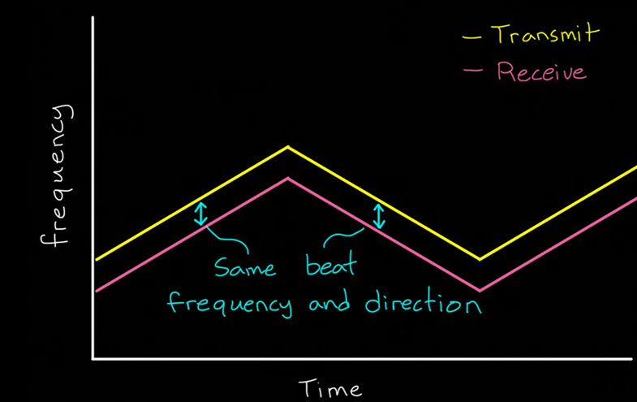
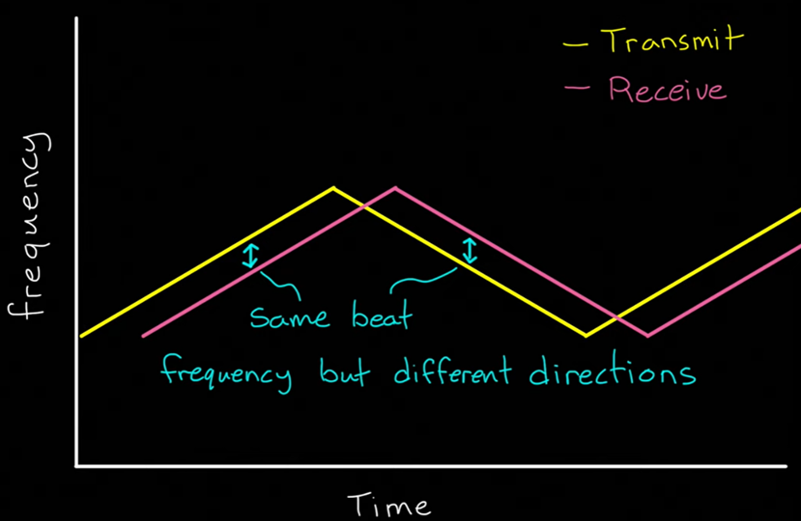
Intro to Radar Systems: Modulating Signals
3. Traingular Signal
Differentiates between doppler shift and time shift
Notes:
Case 1: This case demonstrates an object moving away from the radar at zero range (assuming there is no time shift or it’s in front of the radar “zero range”), a doppler shift is observed (beat frequency).
Case 2: When the particle is at a distance but it’s not moving, there is a time shift but there is no doppler shift.
Now we could differentiate between doppler shift (if the object is moving) or time shift (if the object is within a range) and we could notice if both shifts occurred for the same object. DSM is used to configure the modulating signal (PLL could be frequency controlled)

Slide 11
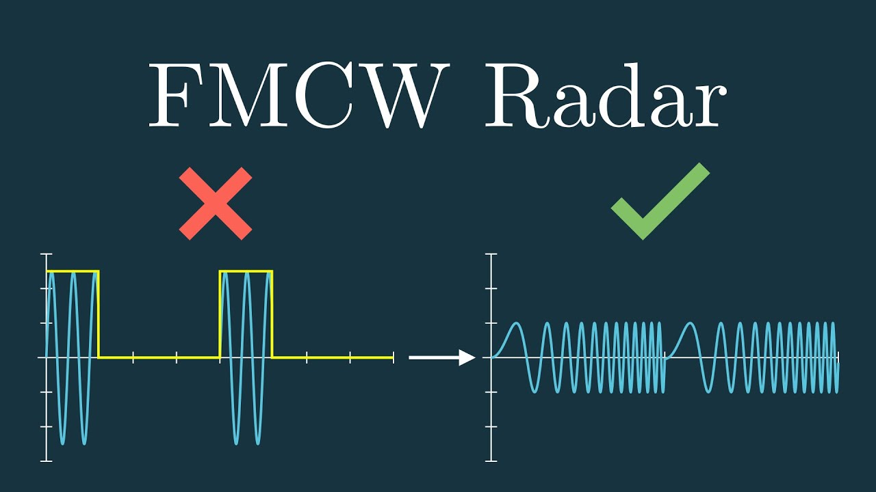
Intro to Radar Systems: Radar Systems
Continuous-wave (CW) Radars
Know stable frequency is transmitted continuously
Low peak transmit power
Pulsed Radars
Short-duration pulse is emitted periodically.
Between every two successive pulses, the receiver waits for the reflected pulse
The pulses need to be relatively powerful so that the returned signal have enough energy to be detected

Slide 12
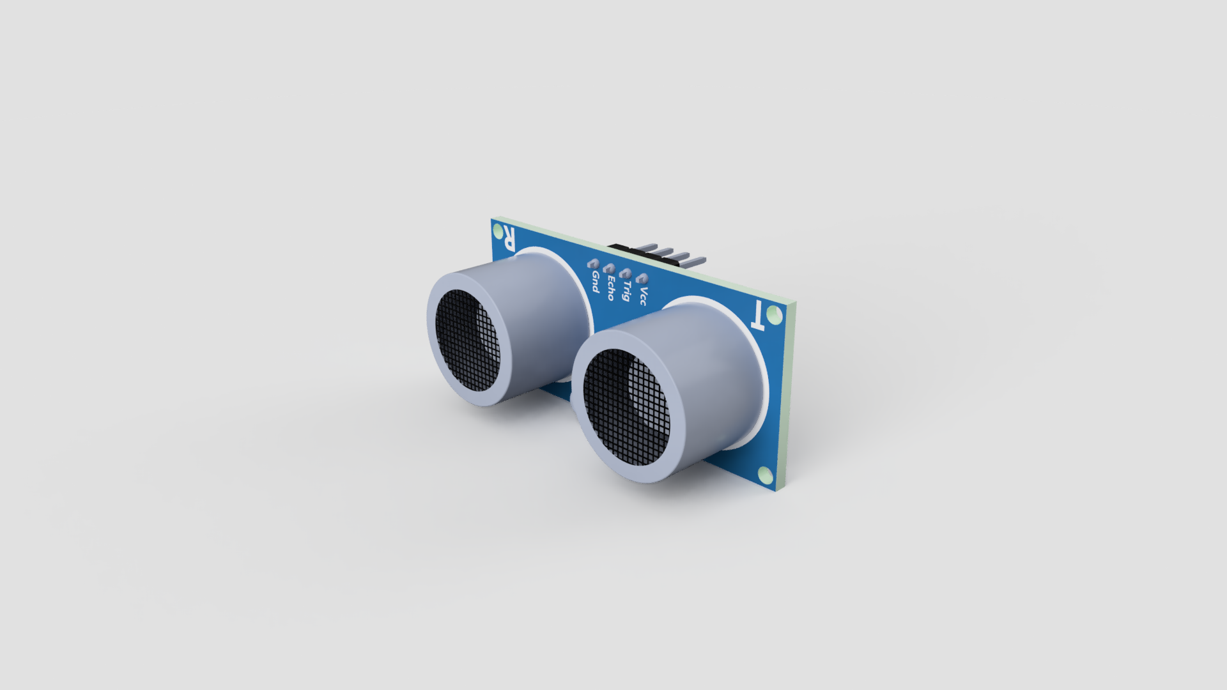
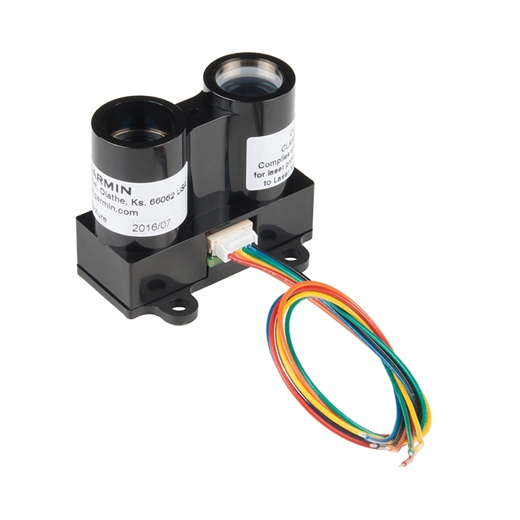
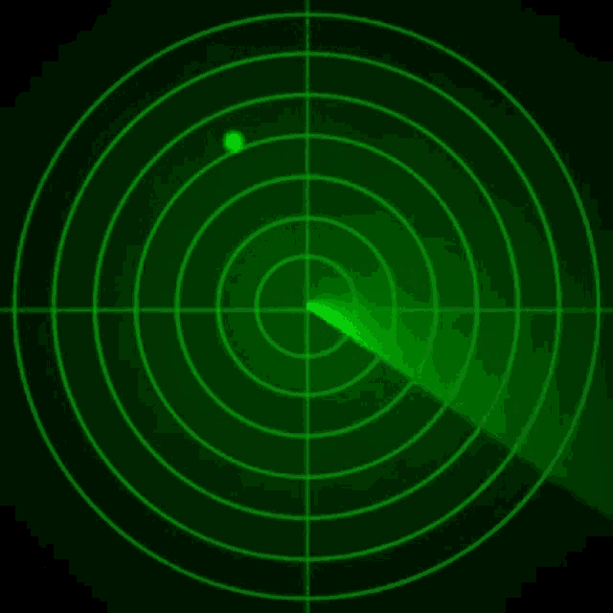
Intro to Radar Systems: Sensor Technologies
1. Ultrasonic Sensors
Sound waves used to detect objects and measure distances (limited range)
2. LiDAR
Laser beams used to measure distances
Interference and difficult weather environment
3. Radar
robust to adverse weather conditions such as rain and snow
Wide distance range

Slide 13

Systems Specifications Formulation

Slide 14
Agenda
Introduction to FMCW Radar Systems
System Specifications Formulation
PLL System Formulation
PLL Circuits Design
Charge Pump and Phase-Frequency Detector
Voltage-Controlled Oscillator
Frequency Dividers
Transmitter System Description
Transmitter Circuits Design
Variable Gain Amplifier
Power Amplifier
Receiver System Description
Receiver Circuits Design
Low-Noise Amplifier
Mixer and Local Oscillator Chain
Baseband Amplifiers

Slide 15
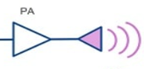
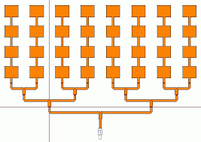

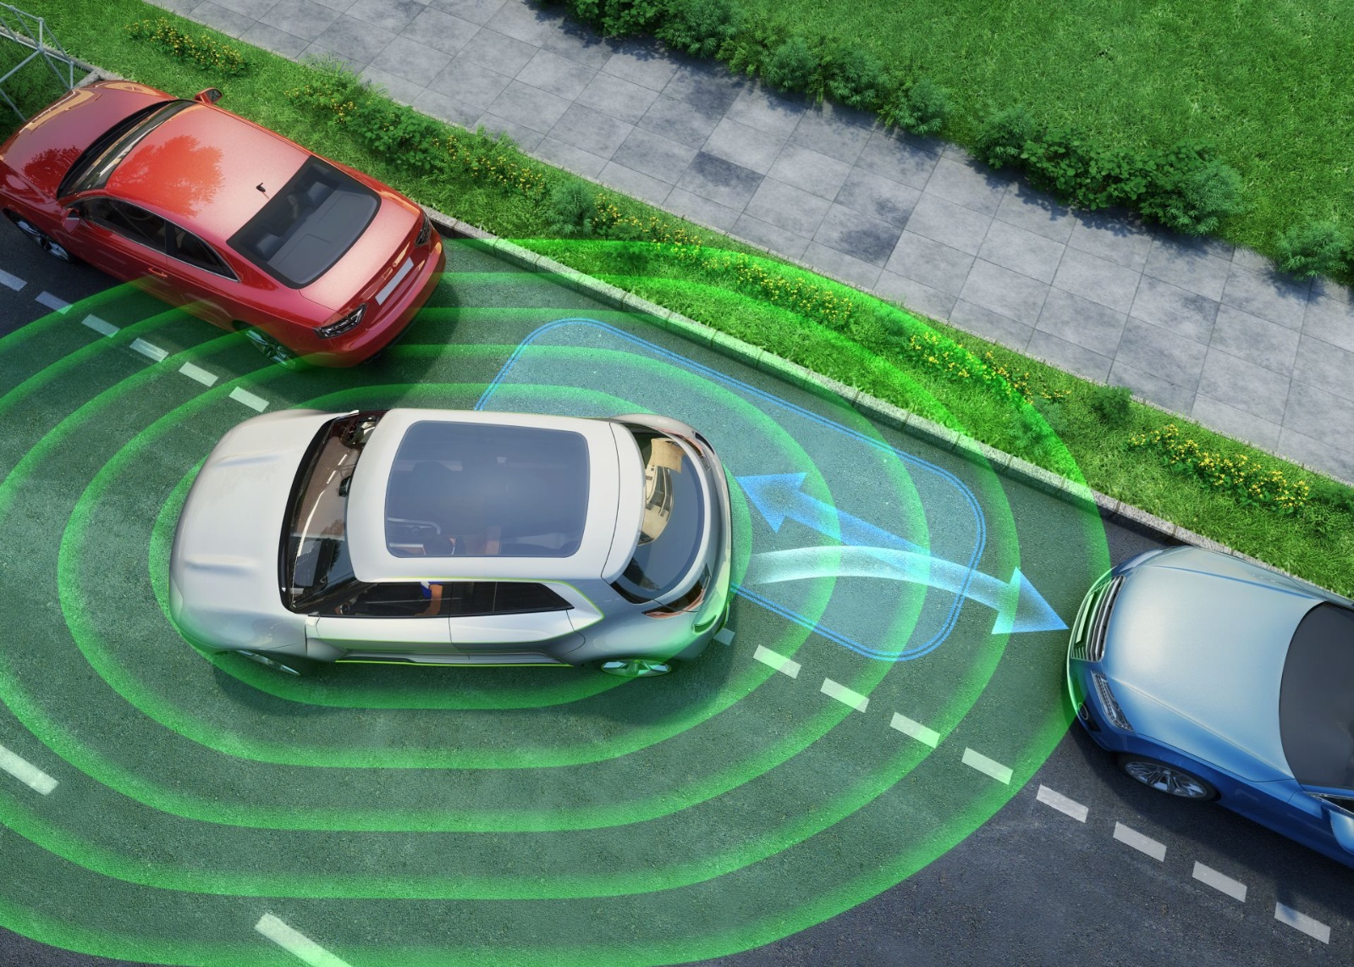
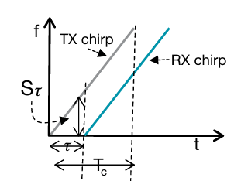
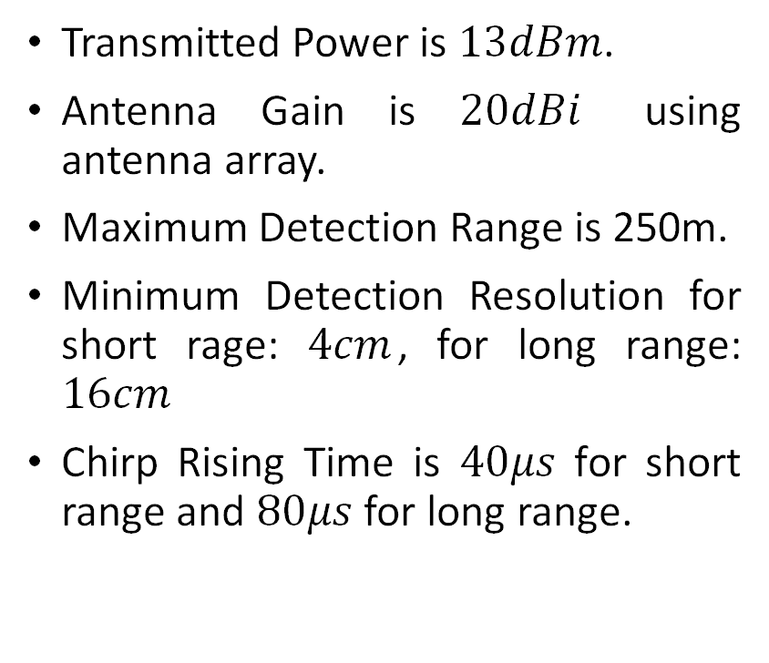
Systems Specification Formulation: Requirements
Transmitted Power is $13dBm$.
Antenna Gain is $20dBi$ using antenna array.
Maximum Detection Range is 250m.
Minimum Detection Resolution for short rage: $4cm$, for long range: $16cm$
Chirp Rising Time is $40μs$ for short range and $80μs$ for long range.

Slide 16
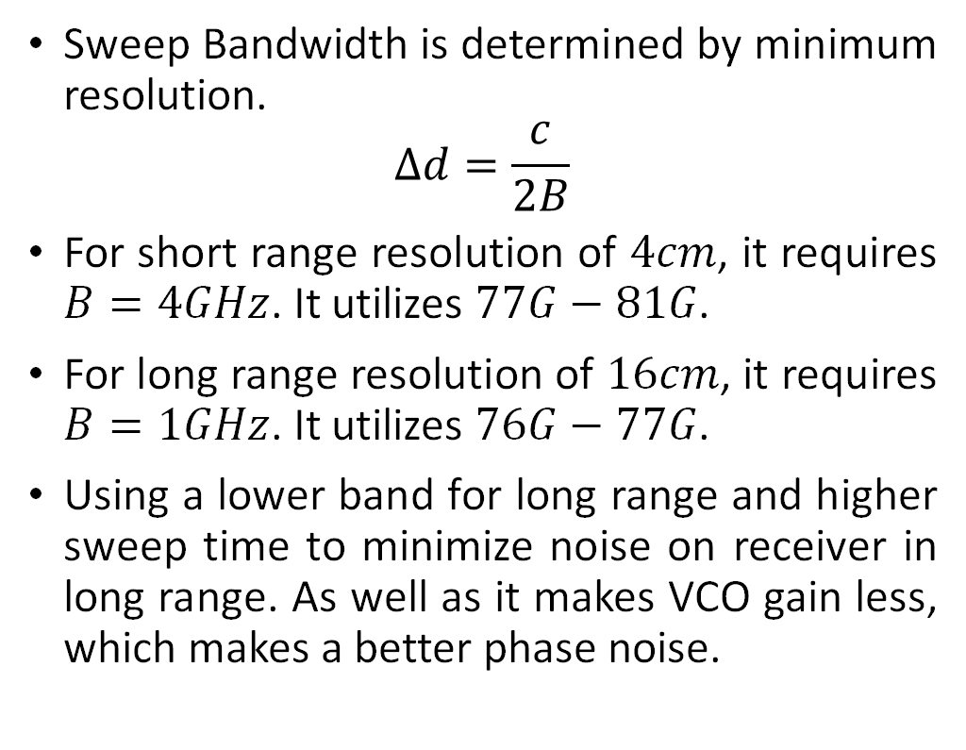
Systems Specification Formulation: Sweep Bandwidth Calculation
Sweep Bandwidth is determined by minimum resolution.
$$∆d=\frac{c}{2B}$$
For short range resolution of $4cm$, it requires $B=4GHz$. It utilizes $77G−81G$.
For long range resolution of $16cm$, it requires $B=1GHz$. It utilizes $76G−77G$.
Using a lower band for long range and higher sweep time to minimize noise on receiver in long range. As well as it makes VCO gain less, which makes a better phase noise.

Slide 17
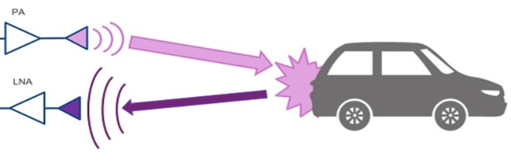
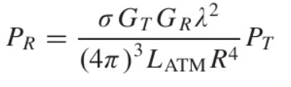
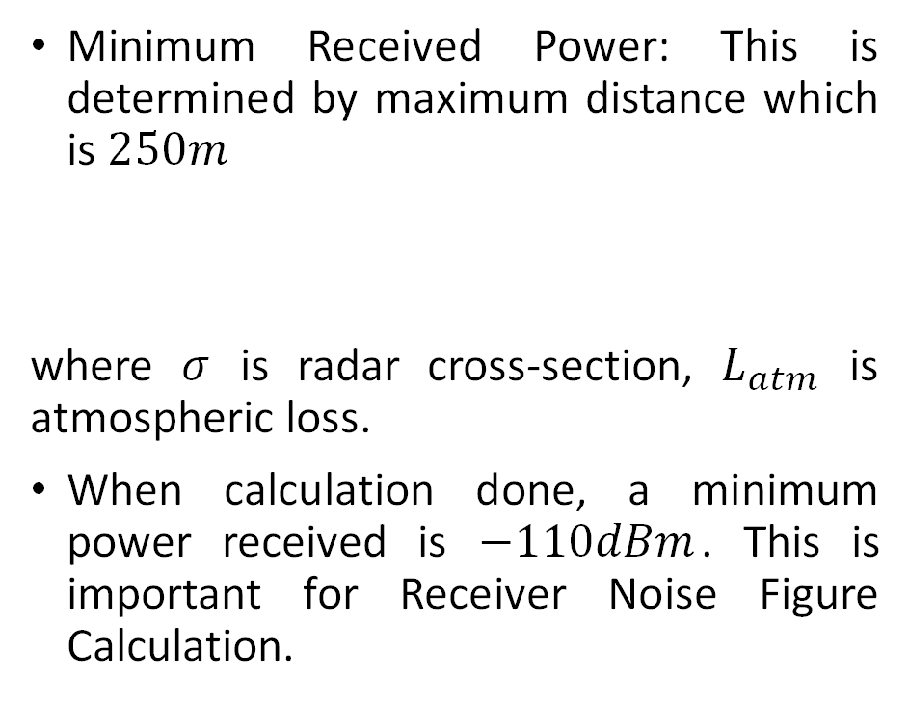
Systems Specification Formulation: Minimum Received Power
Minimum Received Power: This is determined by maximum distance which is $250m$
where $σ$ is radar cross-section, $L_{atm}$ is atmospheric loss.
When calculation done, a minimum power received is $−110dBm$. This is important for Receiver Noise Figure Calculation.

Slide 18
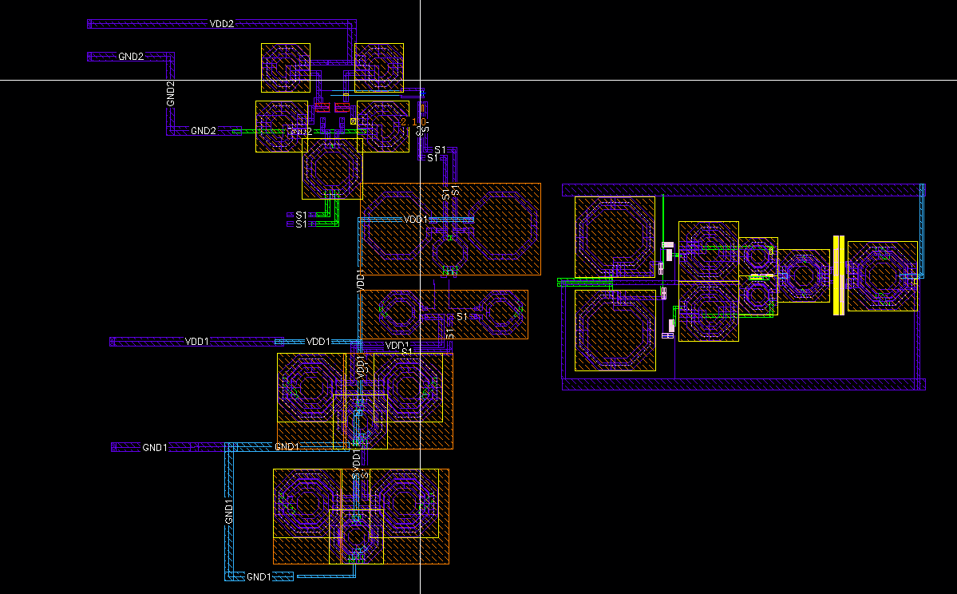
Intro to Radar Systems: Full Chip Layout
missing TIA
LNA
LO Buffer
Frequency Doubler
PA & VGA
missing PLL

Slide 19
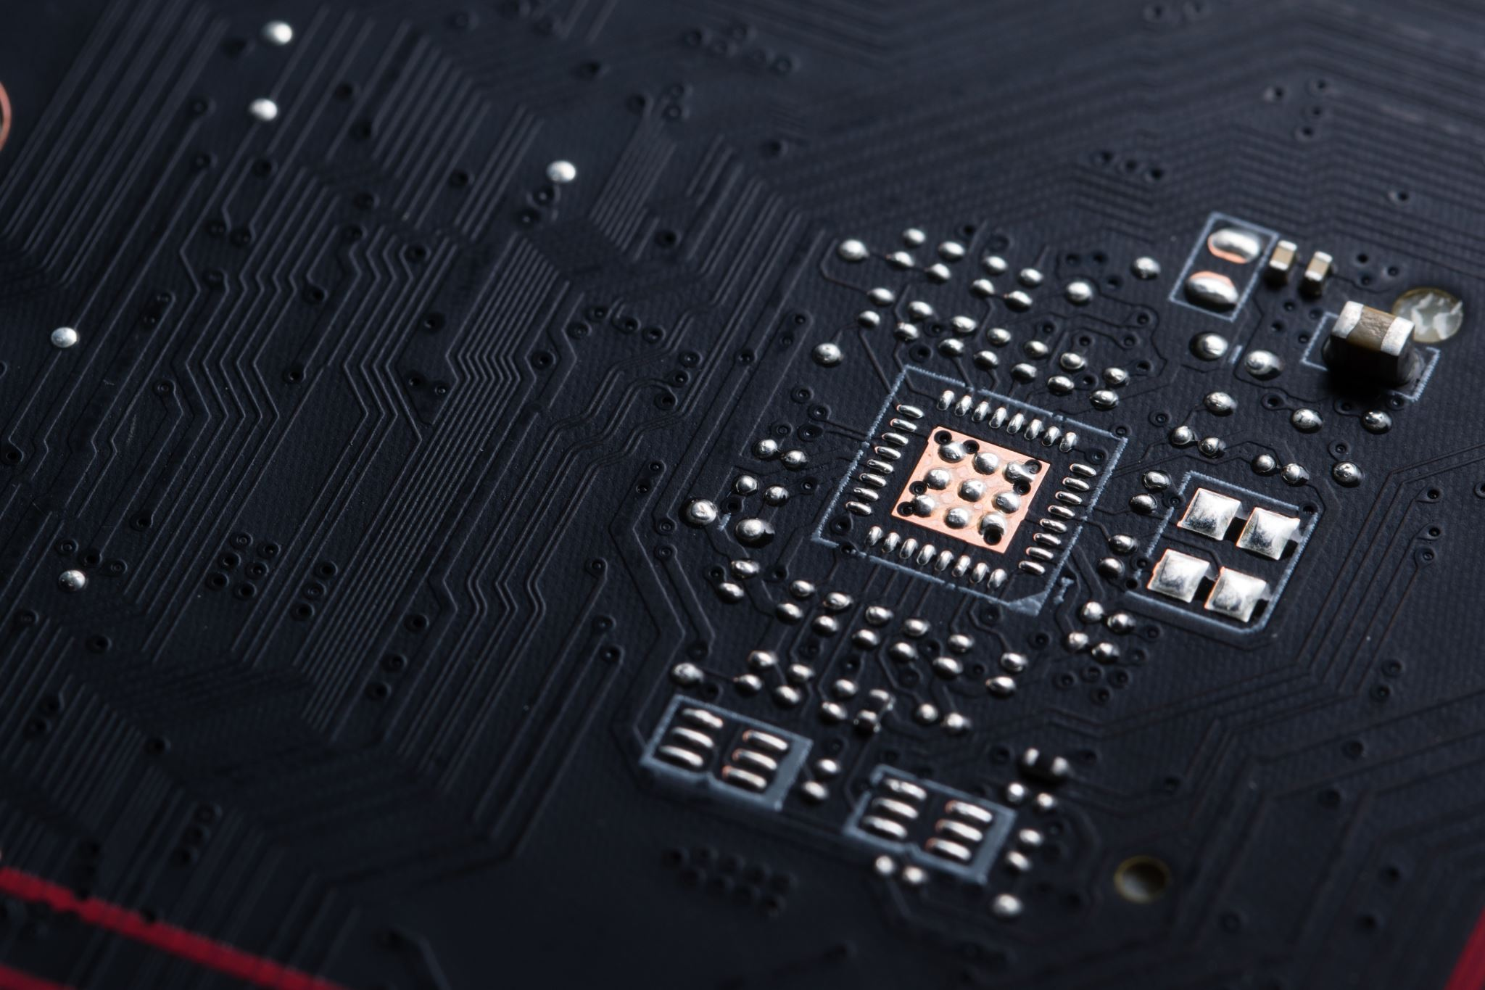
PLL System Formulation

Slide 20
Agenda
Introduction to FMCW Radar Systems
System Specifications Formulation
PLL System Formulation
PLL Circuits Design
Charge Pump and Phase-Frequency Detector
Voltage-Controlled Oscillator
Frequency Dividers
Transmitter System Description
Transmitter Circuits Design
Variable Gain Amplifier
Power Amplifier
Receiver System Description
Receiver Circuits Design
Low-Noise Amplifier
Mixer and Local Oscillator Chain
Baseband Amplifiers

Slide 21
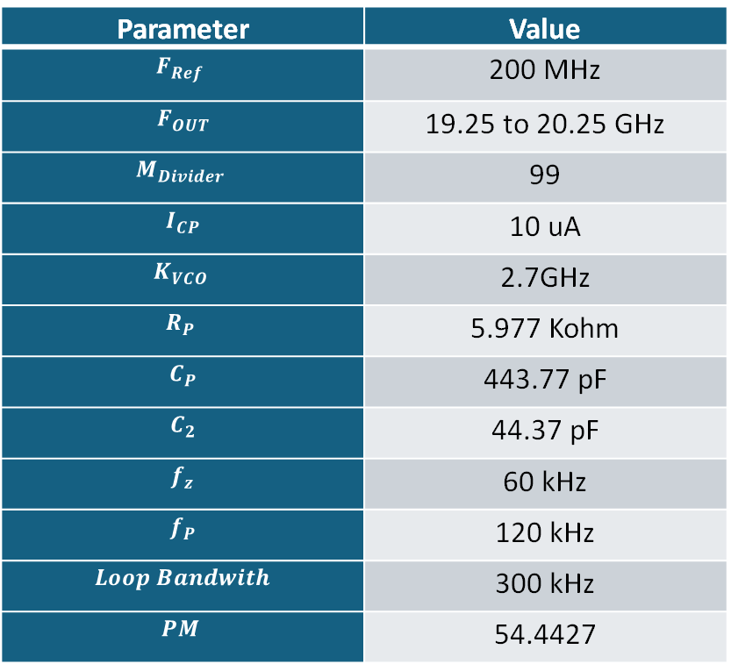
PLL System Formulation
Short Range:
Parameter | Value
$$F_{Ref}$$ | 200 MHz
$$F_{OUT}$$ | 19.25 to 20.25 GHz
$$M_{Divider}$$ | 99
$$I_{CP}$$ | 10 uA
$$K_{VCO}$$ | 2.7GHz
$$R_{P}$$ | 5.977 Kohm
$$C_{P}$$ | 443.77 pF
$$C_{2}$$ | 44.37 pF
$$f_{z}$$ | 60 kHz
$$f_{P}$$ | 120 kHz
$$Loop Bandwith$$ | 300 kHz
$$PM$$ | 54.4427

Slide 22

PLL System Formulation
Long Range:
Parameter | Value
$$F_{Ref}$$ | 200 MHz
$$F_{OUT}$$ | 19 to 19.25 GHz
$$M_{Divider}$$ | 96
$$I_{CP}$$ | 10 uA
$$K_{VCO}$$ | 1.3GHz
$$R_{P}$$ | 7.245 Kohm
$$C_{P}$$ | 732.22 pF
$$C_{2}$$ | 73.222 pF
$$f_{z}$$ | 30 kHz
$$f_{P}$$ | 60 kHz
$$Loop Bandwith$$ | 150 kHz
$$PM$$ | 61.735

Slide 23
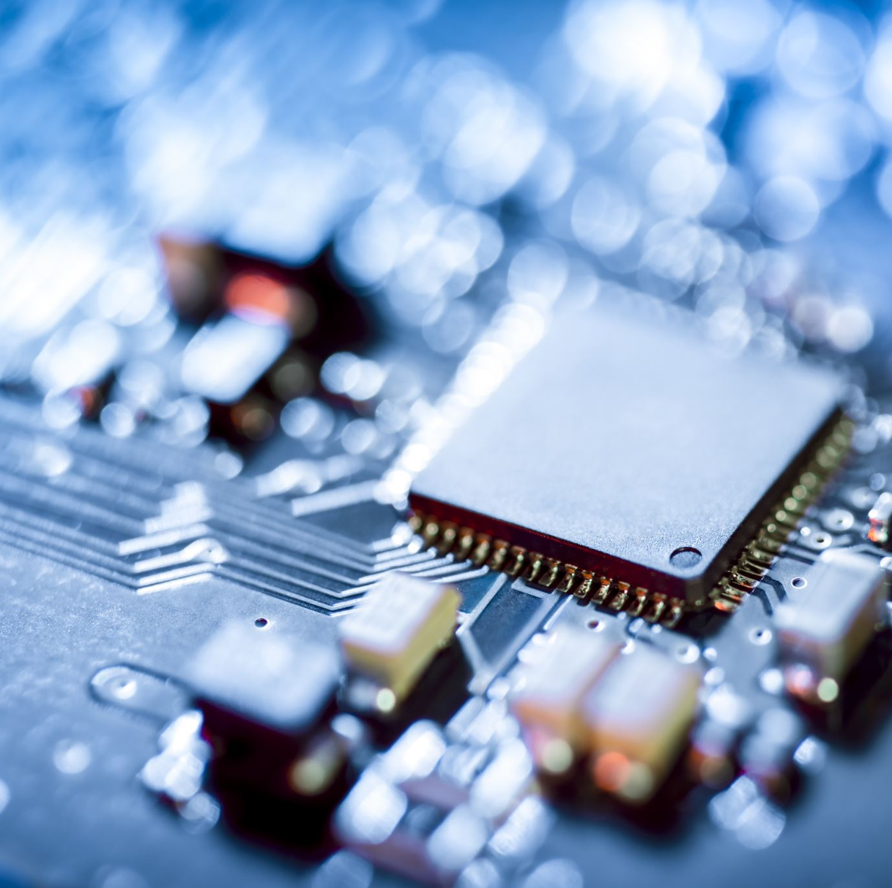
PLL Circuits Design

Slide 24
Agenda
Introduction to FMCW Radar Systems
System Specifications Formulation
PLL System Formulation
PLL Circuits Design
Charge Pump and Phase-Frequency Detector
Voltage-Controlled Oscillator
Frequency Dividers
Transmitter System Description
Transmitter Circuits Design
Variable Gain Amplifier
Power Amplifier
Receiver System Description
Receiver Circuits Design
Low-Noise Amplifier
Mixer and Local Oscillator Chain
Baseband Amplifiers

Slide 25
Agenda
Introduction to FMCW Radar Systems
System Specifications Formulation
PLL System Formulation
PLL Circuits Design
Charge Pump and Phase-Frequency Detector
Voltage-Controlled Oscillator
Frequency Dividers
Transmitter System Description
Transmitter Circuits Design
Variable Gain Amplifier
Power Amplifier
Receiver System Description
Receiver Circuits Design
Low-Noise Amplifier
Mixer and Local Oscillator Chain
Baseband Amplifiers

Slide 26
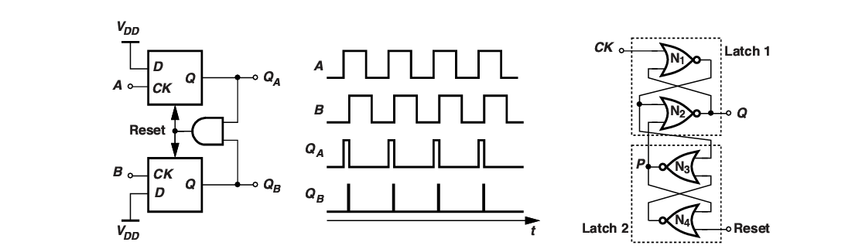
PLL Circuit Design
Phase Frequency Detector

Slide 27
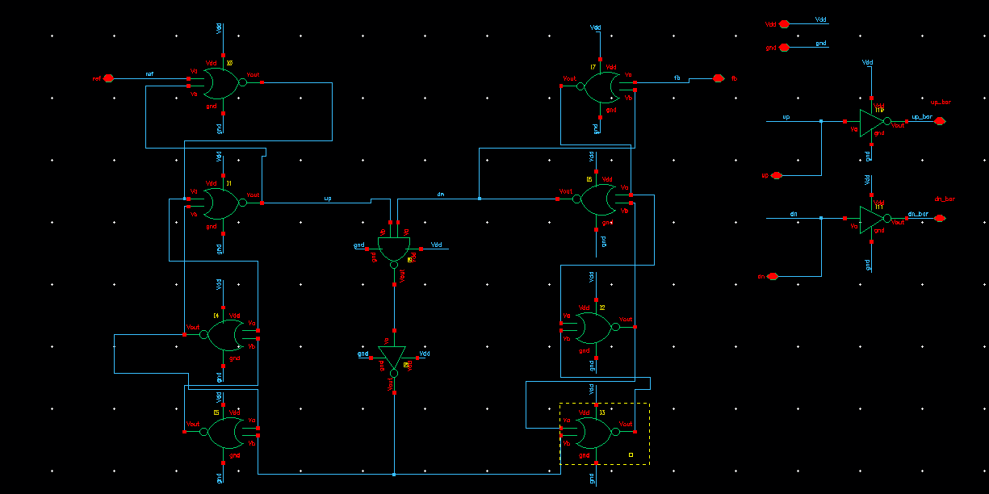
PLL Circuit Design
Phase Frequency Detector
NOR D Flip Flop
And Gate

Slide 28
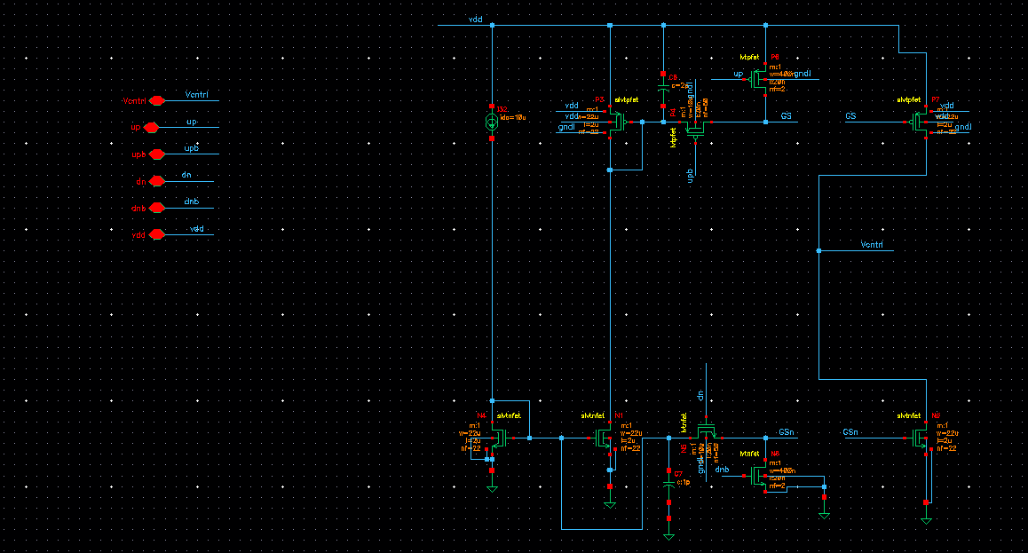
PLL Circuit Design
Charge Pump Schematic:

Slide 29
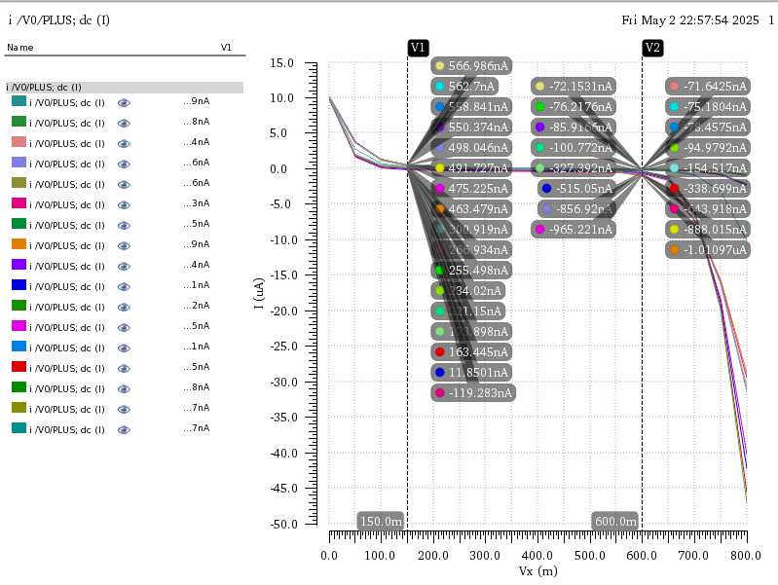
PLL Circuit Design
Charge Pump Static Mismatch:

Slide 30
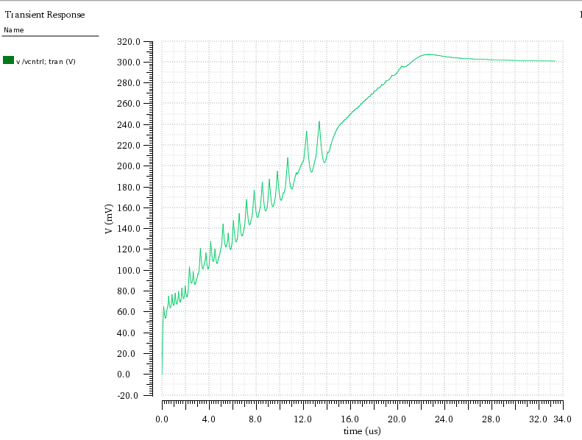
PLL Circuit Design
Charge Pump Dynamic Mismatch:

Slide 31
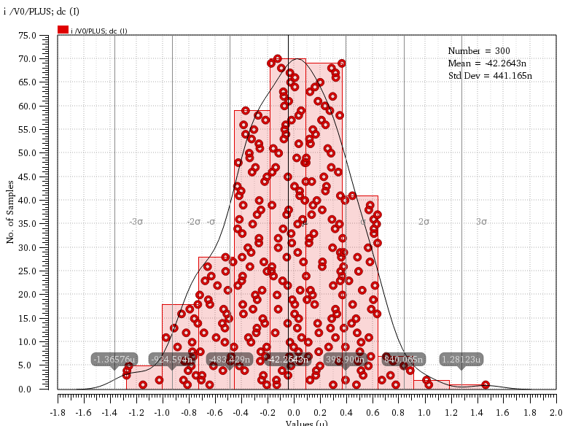
PLL Circuit Design
Charge Pump Current Mismatch in Monte Carlo:

Slide 32
Agenda
Introduction to FMCW Radar Systems
System Specifications Formulation
PLL System Formulation
PLL Circuits Design
Charge Pump and Phase-Frequency Detector
Voltage-Controlled Oscillator
Frequency Dividers
Transmitter System Description
Transmitter Circuits Design
Variable Gain Amplifier
Power Amplifier
Receiver System Description
Receiver Circuits Design
Low-Noise Amplifier
Mixer and Local Oscillator Chain
Baseband Amplifiers

Slide 33
VCO Requirements
Operation for short/medium operation and long range operation.
High Resolution sensing for SR and accurate detection for LR.
Required Range and Resolution
Specs on tuning range and PN.

Slide 34
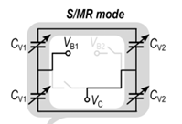
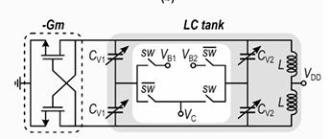
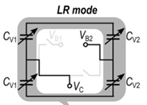
VCO Architecture

Slide 35
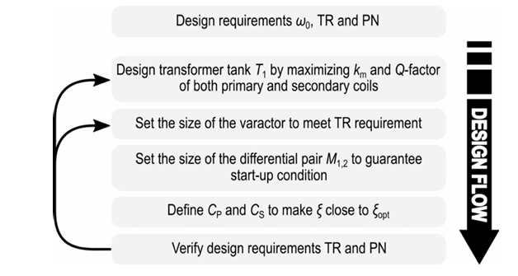
VCO Design

Slide 36
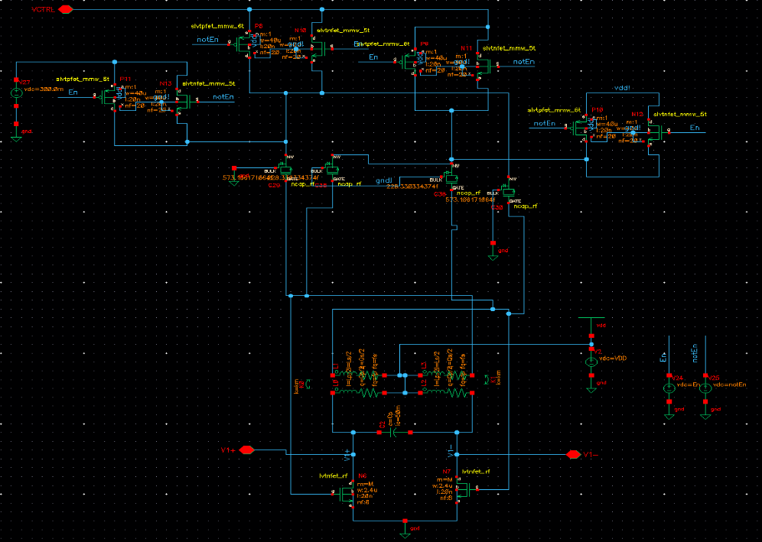
VCO Design

Slide 37
VCO Design/Short range

Slide 38
VCO Design/long range

Slide 39
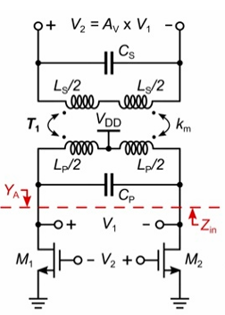
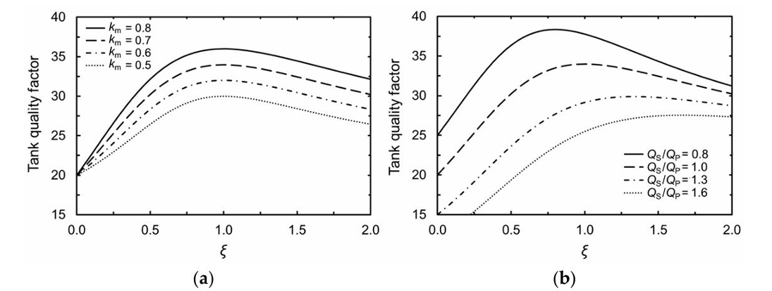
VCO Design

Slide 40
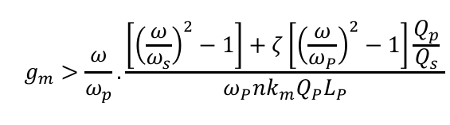
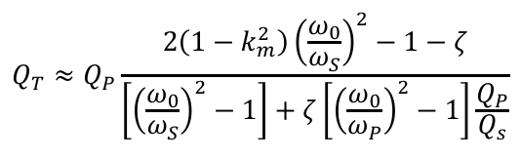
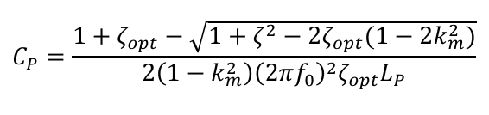
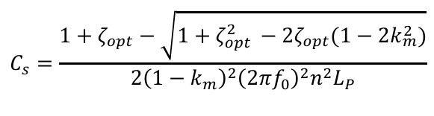
VCO Design

Slide 41
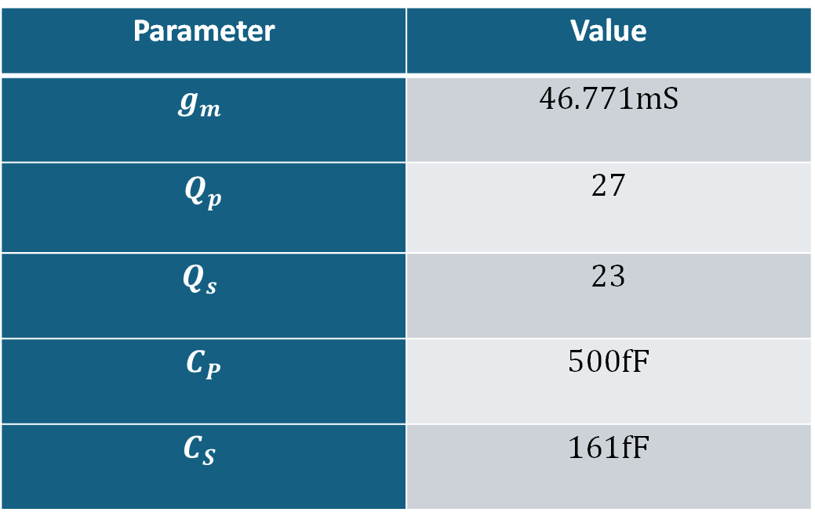
VCO Design parameters
Parameter | Value
$$g_{m}$$ | 46.771mS
$$Q_{p}$$ | 27
$$Q_{s}$$ | 23
$$C_{P}$$ | 500fF
$$C_{S}$$ | 161fF

Slide 42
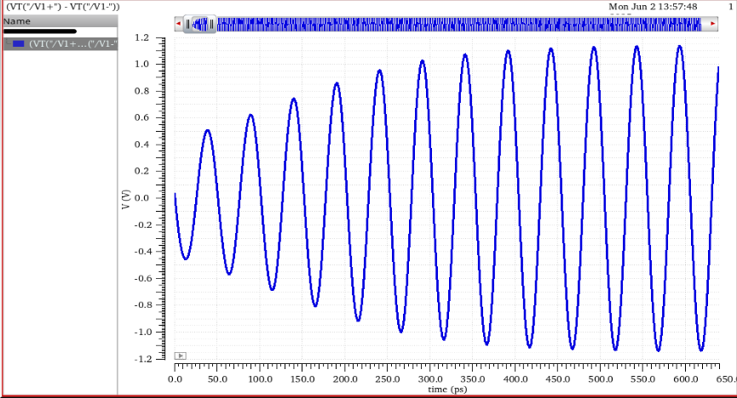
VCO Simulation results – Short Range
VCO Output

Slide 43
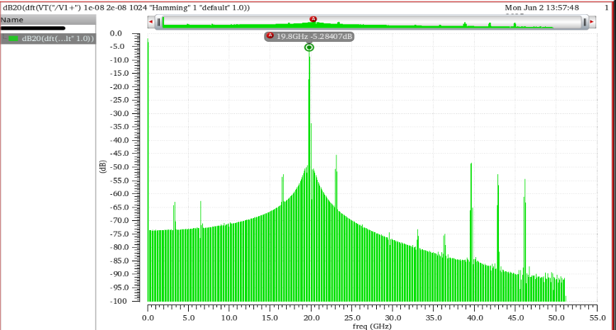
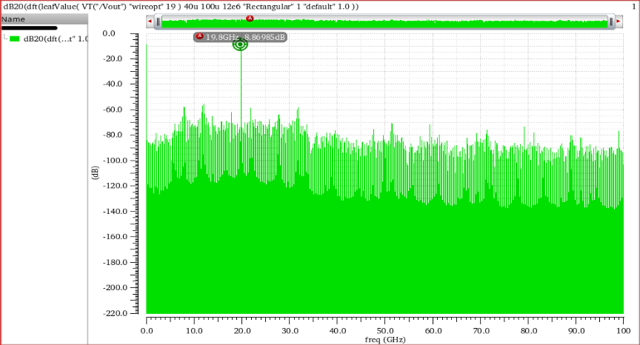
VCO Simulation results – Short Range
Actual FFT
Ideal FFT

Slide 44
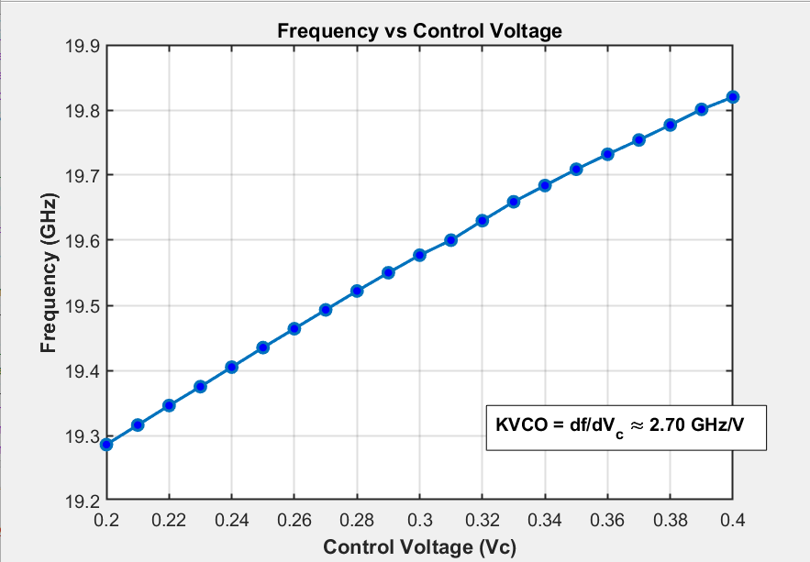
VCO Simulation results – Short Range

Slide 45
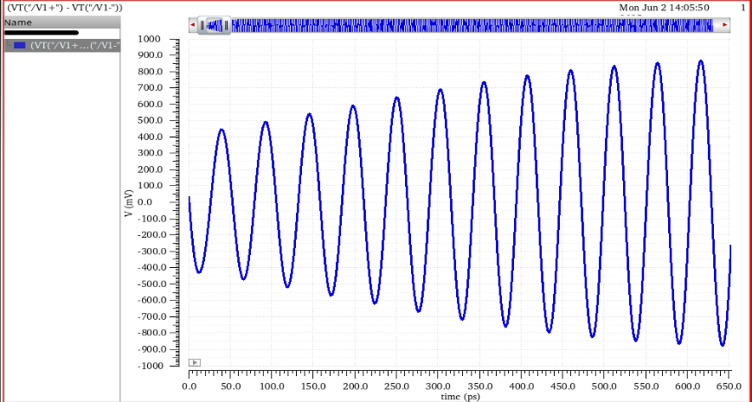
VCO Simulation results – Long range
VCO Output

Slide 46
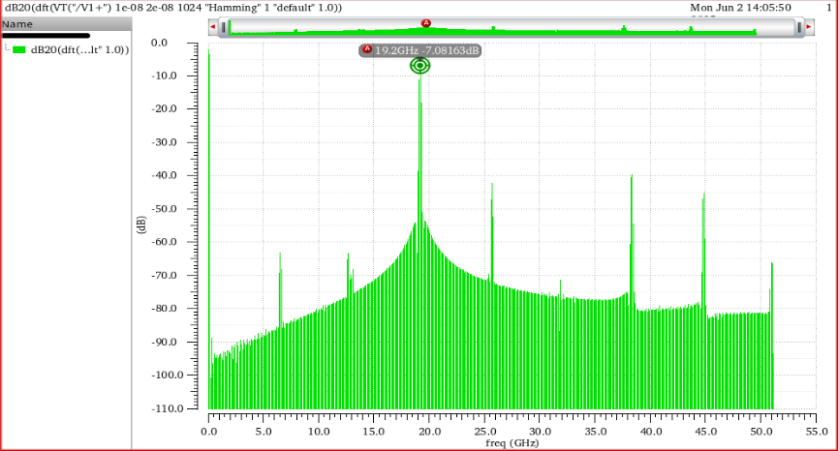
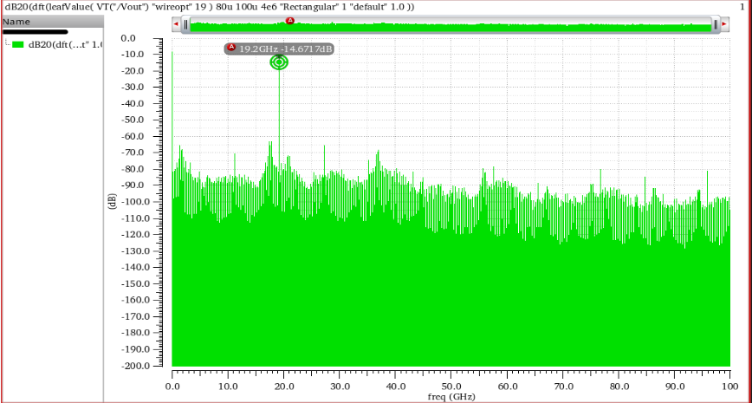
VCO Simulation results – Long range
Actual FFT
Ideal FFT

Slide 47

VCO Simulation results – Long range

Slide 48

VCO Simulation results – Long range
Phase Noise Results @1MHz offset
Parameter | Short range | Long range
$PN$ @ Nominal | -107.2-dBc/Hz | -109.4dBc/Hz
$PN$ @ ss cold temperature low supply | -110.9 dBc/Hz | -110 dBc/Hz
PN @ ff hot temperature, high supply | -103.1 dBc/Hz | -102 dBc/Hz

Slide 49
Agenda
Introduction to FMCW Radar Systems
System Specifications Formulation
PLL System Formulation
PLL Circuits Design
Charge Pump and Phase-Frequency Detector
Voltage-Controlled Oscillator
Frequency Dividers
Transmitter System Description
Transmitter Circuits Design
Variable Gain Amplifier
Power Amplifier
Receiver System Description
Receiver Circuits Design
Low-Noise Amplifier
Mixer and Local Oscillator Chain
Baseband Amplifiers

Slide 50

Frequency Dividers
Current Mode Logic from 20 Ghz to 10 Ghz:

Slide 51

Frequency Dividers
Current Mode Logic Latch (Design):

Slide 52

Frequency Dividers
Current Mode Logic Divider Post Simulation:

Slide 53

Frequency Dividers
Injection Locked Divider from 10 Ghz to 5 Ghz:

Slide 54

PLL Circuit Design
Injection Locked Latch :

Slide 55

Frequency Dividers
Injection Locked Divider Post Simulation :

Slide 56

Frequency Dividers
CMOS D Flip flop (Divider) from 5 Ghz to 2.5 GHz (Design): :

Slide 57

Frequency Dividers
CMOS D Flip flop (Divider) from 5 Ghz to 2.5 GHz (Simulation):

Slide 58

Frequency Dividers
Prescalar Logic Divider 2/3:
Divide by 2
Divide by 3 by using feedback
P=0 div 2 and P=1 div 3
Divide by 3 by using feedback

Slide 59

Frequency Dividers
Injection Locked Latch Layout:

Slide 60

Frequency Dividers
Multi Modulus Divider ( 3 bits) from 8 to 15 :
How to control bits to divide specific values ?

Slide 61

Frequency Dividers
Delta Sigma Modulator (MASH ARCHITECTURE) 20 bits accuracy(m=20):

Slide 62

Frequency Dividers
Simulation Results frequency Division by 12.5 (change 2.5 Ghz to 200 Mhz):
The output = 200 Mhz

Slide 63

Frequency Dividers
Simulation Results frequency Division by 12.5 (change 2.5 Ghz to 200 Mhz):
The output = 200 Mhz

Slide 64
Transmitter System Description

Slide 65
Agenda
Introduction to FMCW Radar Systems
System Specifications Formulation
PLL System Formulation
PLL Circuits Design
Charge Pump and Phase-Frequency Detector
Voltage-Controlled Oscillator
Frequency Dividers
Transmitter System Description
Transmitter Circuits Design
Variable Gain Amplifier
Power Amplifier
Receiver System Description
Receiver Circuits Design
Low-Noise Amplifier
Mixer and Local Oscillator Chain
Baseband Amplifiers

Slide 66

Transmitter System Description
Current buffer variable gain amplifier
interstage transformer
Power amplifier class AB
Output Balun

Slide 67
Transmitter System Description
Why VGA as a driver for power amplifier ?
Roll-off at Corners

Slide 68
Transmitter System Description
Reject common mode noise
Reduce area needed
Reduce insertion loss

Slide 69
Transmitter System Description
Power amplifier Class AB
Spectral leackage
Class AB more robust in high frequency
No need for high efficiency in fmcw

Slide 70
Transmitter System Description
Adaptive bias scheme was adapted
Ensure better efficiency at roll-off
Less power consumption

Slide 71


Transmitter System Description
Chirp signal out of Power amplifier
Power amplifier output FFT

Slide 72

Transmitter Circuits Design
Variable Gain Amplifier & Power Amplifier

Slide 73
Agenda
Introduction to FMCW Radar Systems
System Specifications Formulation
PLL System Formulation
PLL Circuits Design
Charge Pump and Phase-Frequency Detector
Voltage-Controlled Oscillator
Frequency Dividers
Transmitter System Description
Transmitter Circuits Design
Variable Gain Amplifier
Power Amplifier
Receiver System Description
Receiver Circuits Design
Low-Noise Amplifier
Mixer and Local Oscillator Chain
Baseband Amplifiers

Slide 74

Variable Gain Amplifier schematic
Output match circuit
Current buffer variable gain
Amplifier
Current Buffer
Neutralization capacitor
input match circuit

Slide 75

Power Amplifier schematic
Output Balun
Neutralization capacitor
Transform based matching

Slide 76

Power Amplifier adaptive bias schematic
RF input power sensing
Map dc current
Map bias current to PA core
Bias of adaptive bias circuit at class AB

Slide 77

Power Amplifier & VGA Post layout simulation-(Gain)
Gain > 19 dB

Slide 78

Power Amplifier & VGA Post layout simulation-(input match)
S11<-14 dB

Slide 79

Power Amplifier & VGA Post layout simulation-(return isolation)
S12<-57 dB

Slide 80

Power Amplifier & VGA Post layout simulation-(Output match)
S22<-6.6 dB

Slide 81

Power Amplifier & VGA Post layout simulation-(Kf)
Kf>1 so the system is stable across all band

Slide 82

Power Amplifier & VGA Post layout simulation-(Pout vs Frequency)
Pout > 13.5 dBm across all frequency

Slide 83

Power Amplifier & VGA Post layout simulation-(PAE vs Frequency)
PAE > 23% across all frequency

Slide 84

Power Amplifier & VGA Post layout simulation-(Drain efficiency vs Frequency)
PAE > 23% across all frequency

Slide 85

Power Amplifier & VGA Post layout simulation-(PDC vs frequency )
PDC ~= 99mw

Slide 86

Power Amplifier & VGA Post layout simulation-(PAE vs Frequency)
PAE fast high voltage Cold temperature> 25%
PAE typical > 23%
PAE slow Low voltage high temperature> 17%

Slide 87

Power Amplifier & VGA Post layout simulation-(Pout vs Frequency)
PAE typical > 13.6 dBm
PAE slow low Voltage hot temperature> 12.8 dBm
PAE fast High Voltage Cold temperature > 13.9 dBm
Accuracy (+/-) 1dBm

Slide 88

Power Amplifier & VGA Post layout simulation-(Kf vs Frequency)
Kf > 1 at all corners system is stable at all corners

Slide 89

Power Amplifier & VGA Post layout simulation-(S11 vs Frequency)
S11 < -10 dB at all cases.

Slide 90
Power Amplifier & VGA Simulation Result after Post Layout-(Specs achieved)
Spec | Target | achieved
Frequency range | 76-81 GHZ | 76-81 GHZ
Bandwidth | 5 GHZ | 5 GHZ
Gain | - | ~20dB
S11 | -10 dB | -14 dB
S22 | - | -6.5 dB
S12 | - | -57 dB
Psat | - | 15 dBm
Power consumption | - | 99 mw
Area | - | 400u * 240u

Slide 91
Receiver System Description

Slide 92


Receiver System Description: Noise Figure
Knowing that minimum received power is $−110dBm$, and Constant False Alarm rate (CFAR) requires an SNR of 16dB to have detection accuracy of 99%.
We also have for long range the chirp time $80μs$ setting Resolution Bandwidth (RBW) to be $12.5KHz$.
Then, calculating $NF$ of Receiver
Noise Figure of Receiver becomes $7dB$

Slide 93

Receiver System Description: TX Leakage
Since TX and RX operate on same frequency, a finite isolation between TX and RX causes a spillover signal.
This unwanted signal can cause saturation in receiver.
In order to mitigate the effect, a very highly linear receiver could be received.
This causes too much power consumption. So, a new technique must be introduced.

Slide 94


Receiver System Description: Leakage Canceller
A low noise Gm-Cell is added before mixer. This Gm-Cell sees a very low impedance from a baseband transimpedance amplifier.
This makes the best gain of the Gm-Cell while allowing minimal voltage swing on Gm-Cell transistor drains increasing its compression.
A leakage canceller that is a baseband Gm-Cell with a small bandwidth of $50KHz$. In a feedback loop, it acts as a high pass filter supressing high TIA gain at low offsets

Slide 95
Receiver Circuits Design
Low Noise Amplifier

Slide 96
Agenda
Introduction to FMCW Radar Systems
System Specifications Formulation
PLL System Formulation
PLL Circuits Design
Charge Pump and Phase-Frequency Detector
Voltage-Controlled Oscillator
Frequency Dividers
Transmitter System Description
Transmitter Circuits Design
Variable Gain Amplifier
Power Amplifier
Receiver System Description
Receiver Circuits Design
Low-Noise Amplifier
Mixer and Local Oscillator Chain
Baseband Amplifiers

Slide 97

Low-Noise Amplifier: LNA Architecture

Slide 98
Low-Noise Amplifier: LNA Architecture

Slide 99
Low-Noise Amplifier: LNA Architecture

Slide 100
Low-Noise Amplifier: LNA Architecture

Slide 101
Low-Noise Amplifier: LNA Architecture

Slide 102

Low-Noise Amplifier: Nominal Results - Gain

Slide 103

Low-Noise Amplifier: Nominal Results - S11

Slide 104

Low-Noise Amplifier: Nominal Results - NF

Slide 105

Low-Noise Amplifier: Nominal Results - Kf

Slide 106

Low-Noise Amplifier: Nominal Results - B1f

Slide 107

Low-Noise Amplifier: Corner Simulations - S11

Slide 108

Low-Noise Amplifier: Corner Simulations - NF

Slide 109

Low-Noise Amplifier: Corner Simulations - Kf

Slide 110

Low-Noise Amplifier: Corner Simulations - B1f

Slide 111
Receiver Circuits Design
Mixer and LO Chain

Slide 112
Agenda
Introduction to FMCW Radar Systems
System Specifications Formulation
PLL System Formulation
PLL Circuits Design
Charge Pump and Phase-Frequency Detector
Voltage-Controlled Oscillator
Frequency Dividers
Transmitter System Description
Transmitter Circuits Design
Variable Gain Amplifier
Power Amplifier
Receiver System Description
Receiver Circuits Design
Low-Noise Amplifier
Mixer and Local Oscillator Chain
Baseband Amplifiers

Slide 113


Passive Double-Balanced Mixer
Double-Balanced Mixers cancel LO-to-RF Leakage along with any RF-to-IF Leakage as well.
They also outperform simple mixers in gain by $3dB$.
The Choice of Passive is to optimize for whole system linearity and power consumption.

Slide 114

Mixer Conversion Gain

Slide 115


Frequency Multipliers
Multiple Methods exist for frequency multipliers
Injection-Lock Oscillators
Harmonic Extractors
Self-Mixing
Their Noise-Power Consumption Trade-off is high.
A push-push frequency doubler is used for efficient frequency multiplication.

Slide 116


Frequency Multipliers

Slide 117
Frequency Multipliers

Slide 118
Frequency Multipliers

Slide 119
Frequency Multipliers

Slide 120

LO Buffer
LO Buffer is an amplifier that its goal is to saturate input to mixer.
It does that by putting optimum load impedance to make the amplifier operate in its non-linear region becoming insensitive to power after certain input power.

Slide 121
LO Buffer

Slide 122
Receiver Circuits Design
Baseband Amplifiers

Slide 123
Agenda
Introduction to FMCW Radar Systems
System Specifications Formulation
PLL System Formulation
PLL Circuits Design
Charge Pump and Phase-Frequency Detector
Voltage-Controlled Oscillator
Frequency Dividers
Transmitter System Description
Transmitter Circuits Design
Variable Gain Amplifier
Power Amplifier
Receiver System Description
Receiver Circuits Design
Low-Noise Amplifier
Mixer and Local Oscillator Chain
Baseband Amplifiers

Slide 124

Baseband Amplifiers
Trans-Impedance Amplifier
TX Leakage Canceller

Slide 125

Baseband Amplifiers
Trans-Impedance Amplifier
TX Leakage Canceller

Slide 126
Baseband Amplifiers: Why a TIA?
The IF signal exists in current form.
TIA serves as a transresistance amplifier, converting this current into a voltage.
Suitable for subsequent baseband amplification and filtering.

Slide 127

Baseband Amplifiers – TIA: Architecture
Notes:
A simplified schematic of the IV converter is made up of a three-stage amplifier with feedback resistors RF.
Miller and right half-plane zero compensations are performed by the two RC networks, RC–CC.

Slide 128

Baseband Amplifiers – TIA: Architecture

Slide 129
Baseband Amplifiers – TIA: Architecture
Notes:
The first stage of the amplifier is implemented by a differential pair with the resistive load, RL, to meet the low-noise requirement.

Slide 130
Baseband Amplifiers – TIA: Architecture
Notes:
The second stage is a conventional differential topology with active load

Slide 131
Baseband Amplifiers – TIA: Architecture
Notes:
The third stage exploits a common–source pseudo-differential solution, which provides further gain and maximum output swing.

Slide 132
Baseband Amplifiers – TIA: Architecture
Notes:
The circuit adopts a common-mode feedback control (CMFC) loop that detects the CM signal at the amplifier output to properly drive the gate terminals of the second-stage load transistors, M3,4

Slide 133

Baseband Amplifiers – TIA: Architecture

Slide 134

TIA: Simulations - Nominal

Slide 135

TIA: Simulations - Nominal

Slide 136

TIA: Simulations - Nominal

Slide 137


TIA: Simulations @ 27°C

Slide 138

TIA: Simulations @ 27°C

Slide 139

TIA: Simulations @ 27°C

Slide 140


TIA: Simulations @ -45°C

Slide 141

TIA: Simulations @ -45°C

Slide 142

TIA: Simulations @ -45°C

Slide 143


TIA: Simulations @ 125°C

Slide 144

TIA: Simulations @ 125°C

Slide 145

TIA: Simulations @ 125°C

Slide 146
Baseband Amplifiers
Trans-Impedance Amplifier
&
TX Leakage Canceller

Slide 147
Baseband Amplifiers Why the TX Leakage Canceller?
The TIA doubles as a leakage suppression stage by embedding a TX leakage self-cancellation circuit.
This integration enables the cancellation of quasi-dc offsets caused by TX leakage currents at the IF
Improving blocker signal immunity.

Slide 148

Baseband Amplifiers – TX Leakage Canceller: Architecture
Notes:
The RC low-pass filters that drive transistors M9−12 are set to around 50 kHz.

Slide 149

Baseband Amplifiers – TX Leakage Canceller: Architecture

Slide 150
Baseband Amplifiers – TX Leakage Canceller: Architecture

Slide 151
Baseband Amplifiers – TX Leakage Canceller: Architecture

Slide 152
Baseband Amplifiers – TX Leakage Canceller: Architecture

Slide 153
Baseband Amplifiers – TX Leakage Canceller: Architecture

Slide 154
Baseband Amplifiers – TX Leakage Canceller: Architecture

Slide 155
Baseband Amplifiers – TX Leakage Canceller: Architecture

Slide 156
Baseband Amplifiers – TX Leakage Canceller: Architecture

Slide 157
Baseband Amplifiers – TX Leakage Canceller: Architecture

Slide 158

Gm Cell: Simulations - Nominal

Slide 159

Gm Cell: Simulations @ 27°C

Slide 160

Gm Cell: Simulations @ -45°C

Slide 161

Gm Cell: Simulations @ 125°C

Slide 162

Baseband Amplifiers – TIA & TX Leakage Canceller: Architecture

Slide 164

TIA & TX Leakage Canceller: Simulations - Nominal

Slide 165

TIA & TX Leakage Canceller: Simulations @ 27°C

Slide 166

TIA & TX Leakage Canceller: Simulations @ -45°C

Slide 167

TIA & TX Leakage Canceller: Simulations @ 125°C

Slide 168


Slide 169
Layout

Slide 170

Power Amplifier & VGA Layout
Input matching inductor
VGA core
Adaptive bias circuit
Interstage transformer
Power transfomer core
Output Balun
VGA choke inductor

Slide 171

Power Amplifier Core transistor Layout

Slide 172

Power Amplifier Adaptive Bias Layout

Slide 173

VGA transistor Core Layout

Slide 174

LNA Layout
Drain
Inductors
Resonating Capacitor
Source
Inductors
Input Balun

Slide 175

Low-Noise Amplifier: Single Device Layout

Slide 176

Mixer

Slide 177

Frequency Multipliers
Series Inductors
Output Transformers
Devices Layout

Slide 178

LO Buffer
Output Matching
Devices Layout
Gate Shunt LC

Slide 179

Frequency Multiplier: Devices

Slide 180

Frequency Dividers
Resistors =600 ohm
Current Mode Logic Divider Latch Layout:

Slide 181
Frequency Dividers
Injection Locked Latch Layout:

